Slide 1
Requirements Acquisition
Tool
Team : 6
Members: Nabilahmed Patel
Shet Prajval
Tejaswini Mariyada
Limeng Shen
Wenbo Hu
Ashutosh Singh

Slide 2
Requirements
Constraints:
C.1 The RAT must be programmed in JAVA.
C.2 The RAT must be platform independent.
Requirements:
R.1 The RAT must provide a graphical user interface (GUI) to input the description and display the output.
R.1.1 The RAT must provide an input text-area for the user to input the description.
R.1.1.1 The user shall import description file into input text-area by clicking on “import” button.
R.1.1.2 The user shall enter description in input-text area manually by writing.
R.1.1.3 The user can edit the description in the input text-area.

Slide 3
Requirements
R.2 The RAT must have facility for user to identify Business Process, Steps and Actions.
R.2.1 User must be able to highlight verb-noun phrases manually.
R.2.2 User must be able to highlight verb-noun phrases automatically by clicking on “Highlight” Button.
R.2.3 User must be able to identify Business Process, Steps and Actions from highlighted verb-noun phrases.
R.2.4 RAT must have facility for user to provide other information related to business process in form of dialog box.
R.2.5 RAT must provide output text-area to display the generated requirements.
R.2.5 RAT shall display the identified business processes in the output text-area.

Slide 4
Requirements
R.3 User must be able to generate the requirements from identified business process.
R.3.1 RAT shall provide the “Generate” Button for user to click and generate the requirements.
R.3.2 RAT must generate the requirements from the information provided by the user and the identified business process.
R.4 RAT must provide output text-area to display the generated requirements.
R.4.1 RAT must display the generated requirements in the output text-area.

Slide 5
Requirements
R.5 RAT must provide the facility for user to edit the identified business process.
R.5.1 User must be able to edit and delete the identified business process.
R.5.2 RAT shall display the edited business process in the output text-area.
R.6 RAT shall provide the facility to export/save the generated requirements in the form of document.
R.6.1 RAT shall provide an “Save” button to export generated requirements into file.

Slide 6
Use Case Modelling
Abstract Use Cases:
UC1: Identify Business Process, Steps and Actions(Actor: User, System: RAT)
UC2: Generate Requirements(Actor: User, System: RAT)
UC3: Edit Business Process(Actor: User, System: RAT)
UC4: Export Requirements(Actor: User, System: RAT)

Slide 7
Use Case Modelling
High Level Use Cases:
UC1: Identify Business Process, Steps and Actions
TUCBW The user clicks on the highlight button.
TUCEW The user classifies into business processes, steps and actions.
UC2: Generate Requirements
TUCBW The user clicks on the generate button.
TUCEW The user views the generated requirements.

Slide 8
Use Case Modelling
High Level Use Cases:
UC3: Edit Business Process
TUCBW The user clicks on the text and edits it.
TUCEW The user sees the edited requirements.
UC4: Export Requirements
TUCBW The user clicks on the export button.
TUCEW The user gets a saved file.

Slide 9
Use Case Modelling
Expanded Use Cases:
UC1: Identify Business Processes, Steps and Actions
Actor: User | System: RAT
 | 0. System displays the GUI.
1. TUCBW user inputs the description. | 2. System shows the description in the input text-area.
3. User repeatedly selects verb-noun phrases and identifies as business process. | 4. System pops-up the corresponding dialog-box.
5. User inputs the business process, steps, actions and priorities into the dialog-box. | 6. System stores business processes in list and displays in the output text-area.
7. TUCEW user sees the identified business processes.

Slide 10
Use Case Modelling
Expanded Use Cases:
UC2: Generate Requirements
Actor: User | System: RAT
 | 0.The RAT displays the identified business processes in to the output textarea.
1. TUCBW the user clicks on the generate button. | 2.The system generates requirements from the identified business processes and displays them into output textarea.
3.The user shows the generated requirements in output textarea.

Slide 11
Use Case Modelling
Expanded Use Cases:
UC3: Edit Business Processes
Actor: User | System: RAT
 | 0. The System displays the identified business processes in the output text-area.
1. TUCBW user right clicks on the identified business process. | 2. The system pops-up menu.
3. The user selects the edit or delete option from the menu. | 4. The system pops-up the dialog-box for corresponding business process.
5. The user repeatedly edits business processes of output text-area. | 6. System makes relevant changes into the list and output text-area.
7. TUCEW the user sees business process is successfully edited.

Slide 12
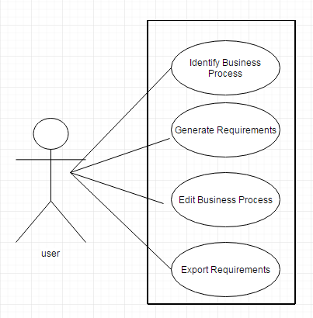
Use Case Modelling

Slide 13
Use Case Modelling
Requirement-UseCase Tracibility Matrix:
Requirement | Priority | UC1 | UC2 | UC3 | UC4
R01
R02 | 1 | X
R03 | 2 |  | X
R04
R05 | 3 |  |  | X
R06 | 4 |  |  |  | X
UC PRIORITY |  | 1 | 2 | 3 | 4

Slide 14
Domain Modelling
Brainstorming:
Domain Information of Requirement Acquisition
A user is given³ the textual⁴ description¹. A user¹ is able to edit³ the description. The verb-noun phrases¹ are identified³ by the user from the given description. The identified verb-noun phrases are categorized³ into business processes¹, steps¹ and actions¹. The business process consists of steps⁷,and the step consists of actions⁷.The requirements¹ are generated³ from categorized business processes , steps and actions . The generated requirements are in an ordered⁴ format¹. The requirements are saved³ by the user.

Slide 15
Domain Modelling
Classification:
Brainstorming List | Classification Result | Rule
description¹ | (C) Description | 1(a)
requirement¹ | (C) Requirement | 1(a)
given³ | (AS) given ( user, description) | 3
textual⁴ | (V) textual | 4
user¹ | (C) User | 1(a)
edit³ | (AS) edit (user, description) | 3
identify³ | (AS) identify (user, verb-noun phrase) | 3
verb-noun phrase¹ | (C) Verb-Noun Phrase | 1(a)
business processe¹ | (C) Business Process | 1(a)
step¹ | (C) Step | 1(a)

Slide 16
Domain Modelling
Classification:
Brainstorming List | Classification Result | Rule
action¹ | (C) Action | 1(a)
generated³ | (AS) generated (business processes, requirements) | 3
generated³ | (AS) generated (steps, requirements) | 3
generated³ | (AS) generated (actions, requirements) | 3
process consists of⁷ | (AG) consists of (business process, steps) | 7
steps consists of⁷ | (AG)consists of (steps, actions) | 7
ordered⁴ | (V) ordered | 4
format¹ | (A) format | 1(e)
save³ | (AS) save (user, requirements) | 3

Slide 17
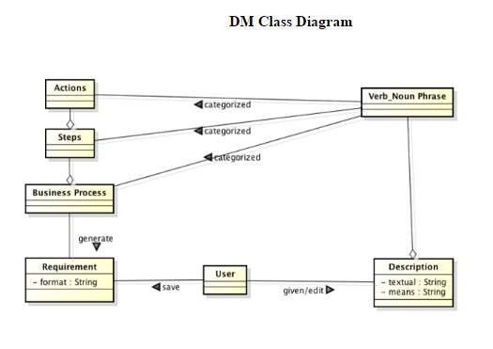
Domain Modelling

Slide 18
Object Interaction Modelling
Scenario
UC1: Identify Business Process, Steps and Actions
5. 6. 6.1 6.1.1 6.1.2 6.1.2.1 6.1.2.2 6.1.3 6.1.4 6.1.5 6.2 | User inputs the business processes, steps, actions and priorities from the dialog-box. The GUI sends the business processes and the parameters including steps, actions, priorities to BPController. For each business process, The BPController creates BusinessProcess object using business process. For each parameter, BPController creates the Object or attribute of corresponding Parameter. BPController adds parameter Object or attribute into BusinessProcess Object. The BPController sends the BusinessProcess object to StoreMgr. The StoreMgr saves the BusinessProcess object in List. The BPController sends the BusinessProcess object in string format to the GUI. GUI displays the business processes in the output text-area.

Slide 19
Object Interaction Modelling
ScenarioTable:
# | Subject | Subject action | Other data/Objects | Object Acted Upon
5. | User | inputs | business processes,steps,actions and priorities | GUI
6 | GUI | sends | business processes and parameters | BPController
6.1 | For each business process
6.1.1 | BPController | creates | busineess process | Business process object
6.1.3 | For each parameter
6.1.3.1 | BPController | creates | parameter | Object or attribute
6.1.3.2 | BPController | adds | Object or attribute | BusinessProcess Object
6.1.4 | BPController | sends | Business Process Object | StoreMgr
6.1.5 | StoreMgr | saves | Business Process Object | List
6.1.6 | BPController | sends | Business Process Object | GUI
6.2 | GUI | displays | business process | output text-area

Slide 20
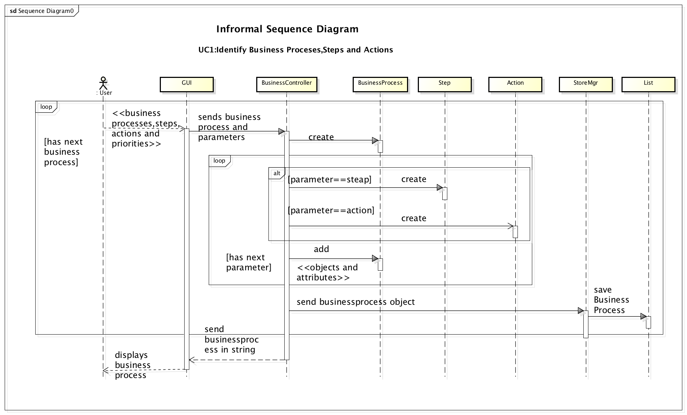

Slide 21
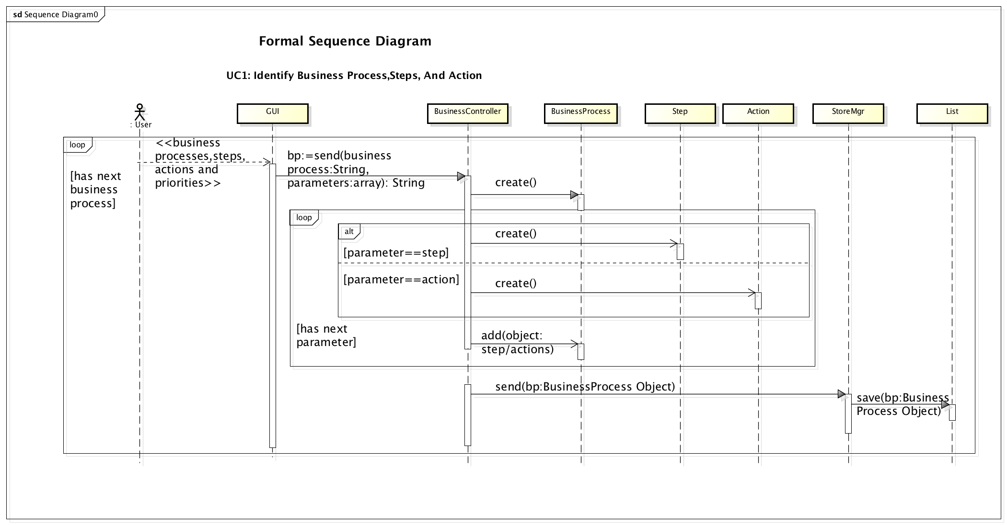

Slide 22
Object Interaction Modelling
Scenario
UC2: Generate Requirements
2 3 3.1 3.2 3.3 3.4 3.5 3.6 | The user clicks the generate button. For each business process, The RATController fetches business process object from StoreMgr for business process. The RATController passes fetched business process object to parser. The Parser parses business process object and generates the requirement. The Parser sends back generated requirements to RATController. The RATController sends requirements to the GUI. The GUI shows the generated requirements.

Slide 23
Object Interaction Modelling
ScenarioTable:
# | Subject | Subject action | Other data/Objects | Object Acted Upon
2. | User | clicks | generate button | GUI
3 | For each business process
3.1 | RATController | fetches | fetched business process object | StoreMgr
3.2 | RATController | passes | Business Process object | Parser
3.3 | Parser | parses | requirements | Business process object
3.4 | Parser | sends | generated requirements | RATController
3.5 | RATController | sends | requirements | GUI
3.6 | GUI | shows | generated requirements | User

Slide 24
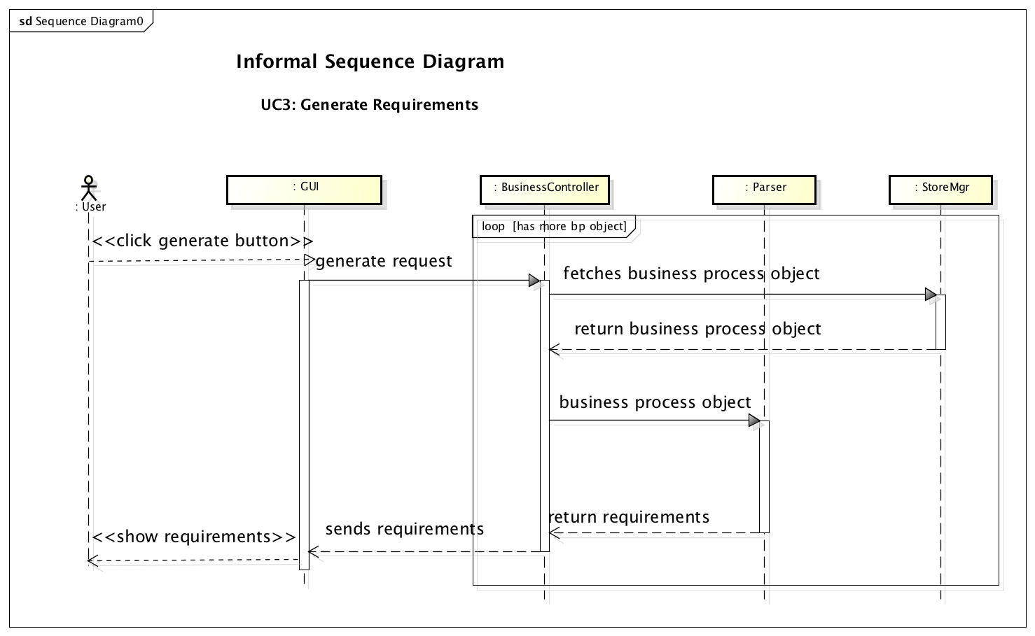

Slide 25
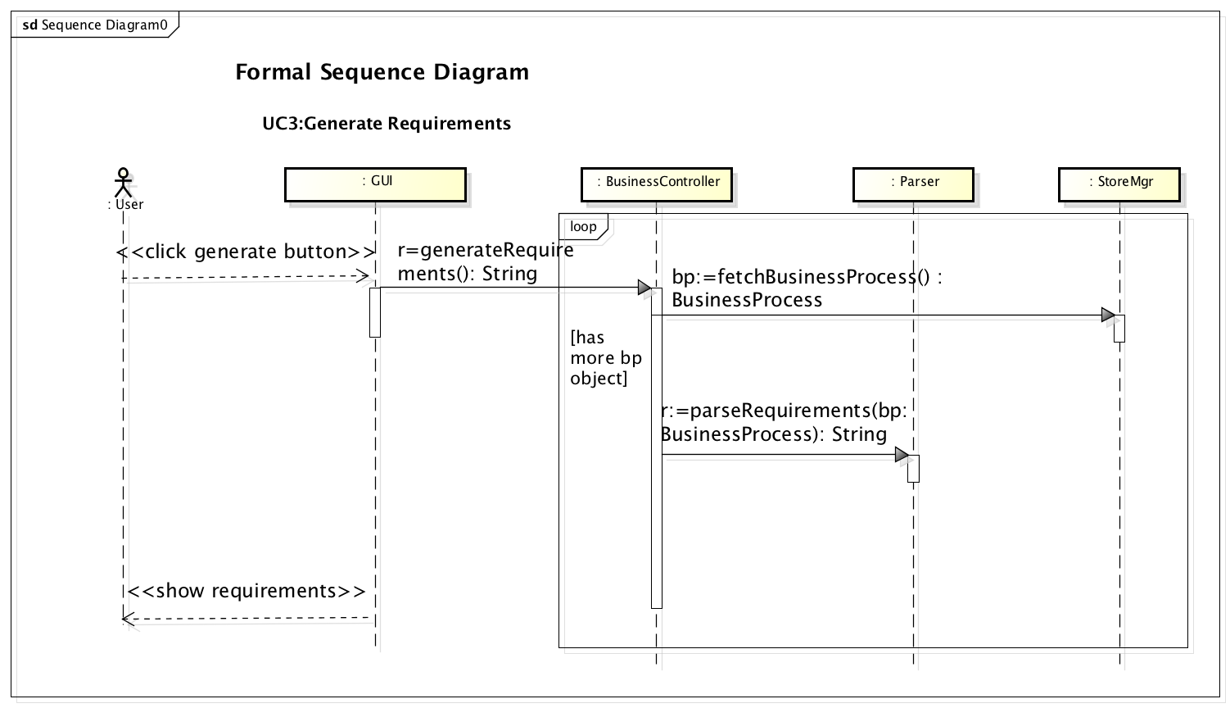

Slide 26
Object Interaction Modelling
Scenario
UC3: Edit Business Processes
3. 4.1 4.2 4.2.1 4.2.2 4.2.2.1 4.2.3 4.2.3.1 4.2.3.2 4.2.3.1.1 4.2.3.1.2 4.2.3.3 4.2.3.4 4.2.3.5 4.3 | The User edits the business processes of output text-area. The GUI sends the business processes and the parameters including steps, actions, priorities to the BPController. For each business process, The BPController sends the business process and action to StoreMgr. If action is delete, StoreMgr removes BusinessProcess object for business process. If action is edit, StoreMgr sends BusinessProcess object for business process to BPController. For each parameter, BPController edits the Object or attribute of corresponding Parameter BPController edits parameter Object or attribute into BusinessProcess Object. The BPController sends the BusinessProcess object to StoreMgr. The StoreMgr saves the BusinessProcess object in List. The BPController sends the BusinessProcess object in string format to the GUI. GUI displays the edited business processes in the output text-area.

Slide 27
Object Interaction Modelling
ScenarioTable:
# | Subject | Subject action | Other data/Objects | Object Acted Upon
4. | User | edits | output text-area | Business processes
4.1 | GUI | sends | business processes and parameters | BPController
4.2 | For each business process
4.2.1 | BPController | sends | Business processes, action | StoreMgr
4.2.2 | If the action is delete
4.2.2.1 | StoreMgr | removes | Business Process object | List
4.2.3 | If the action is a edit
4.2.3.1 | StoreMgr | sends | Business Process object | BPController
4.2.3.2 | For each parameter
4.2.3.2.1 | BPController | edits | parameter | Object or attribute
4.2.3.2.2 | BPController | edits | Object or attribute | BusinessProcess Object

Slide 28
Object Interaction Modelling
ScenarioTable (Cont.)
# | Subject | Subject action | Other data/Objects | Object Acted Upon
4.2.3.2 | BPController | sends | Business Process Object | StoreMgr
4.2.3.4 | StoreMgr | saves | Business Process Object | List
4.2.3.5 | BPController | sends | Business Process Object | GUI
4.3 | GUI | displays | business process | output text-area

Slide 29
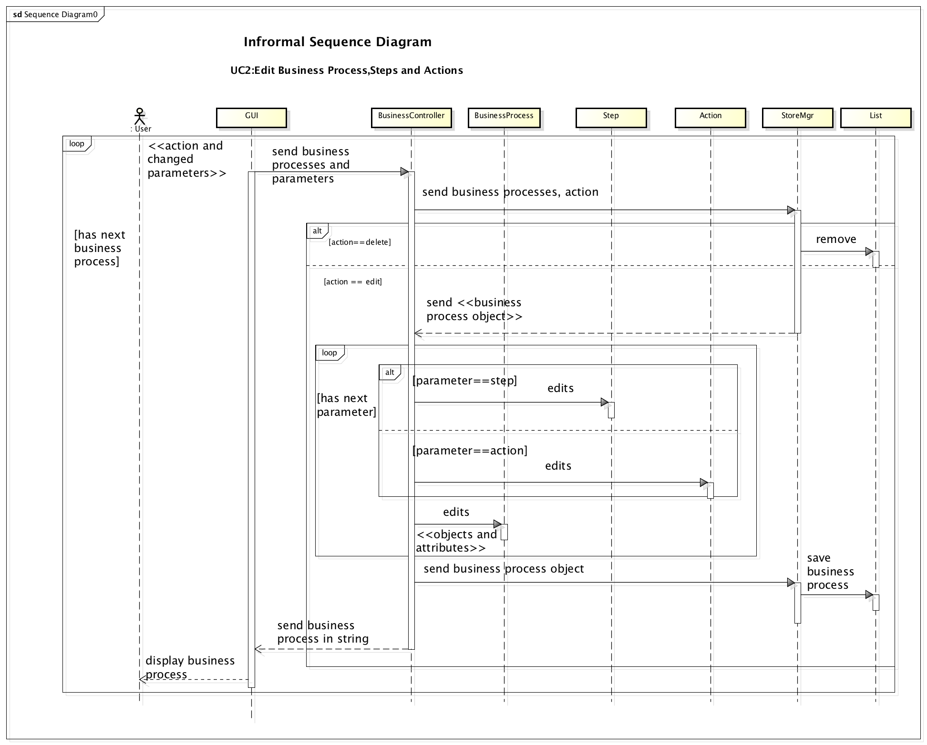

Slide 30
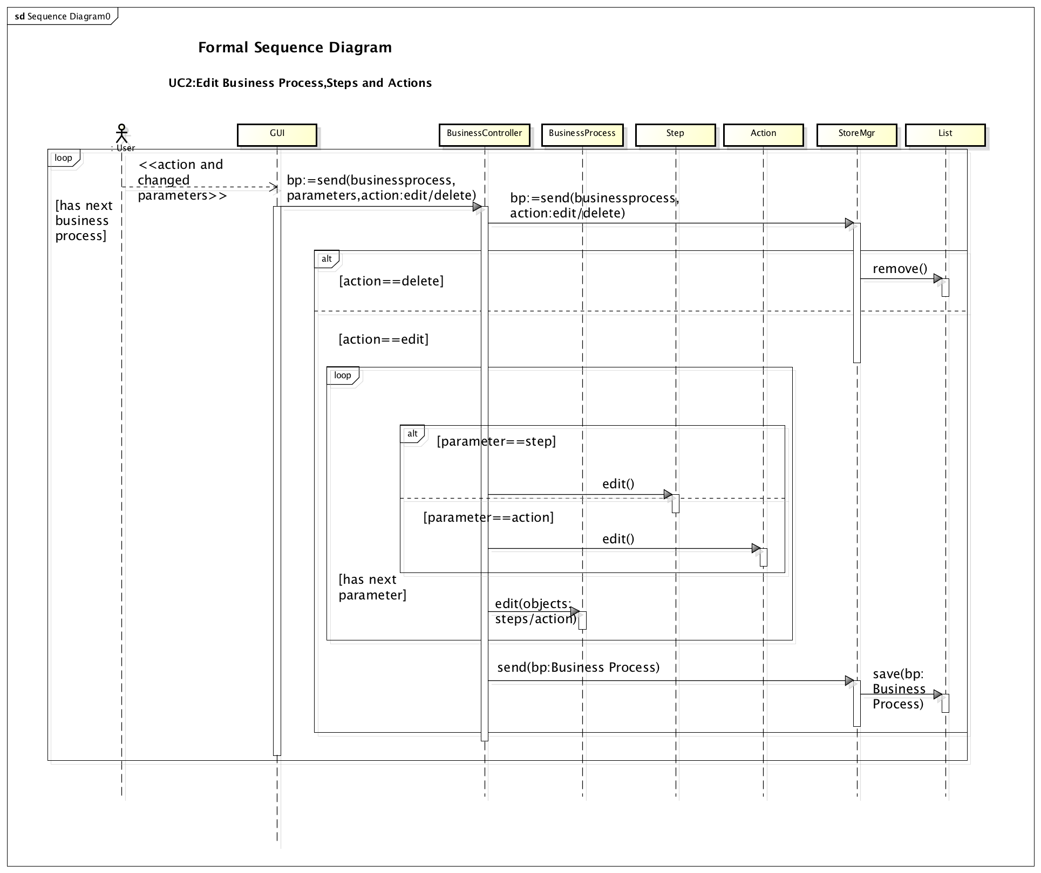
Object Interaction Modelling

Slide 31
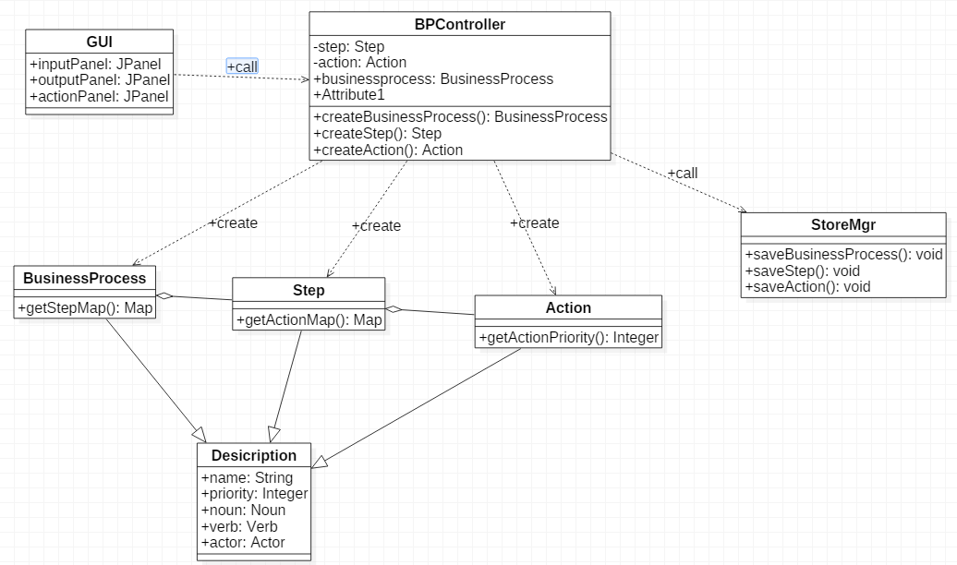
Design Class Diagram

Slide 32
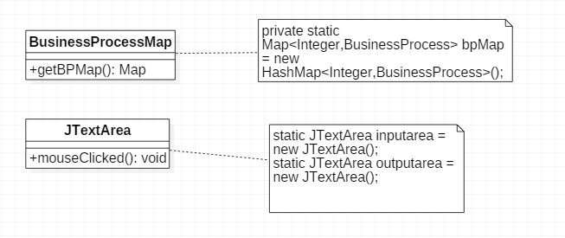
Applying Patterns
Singleton Pattern:
Problem: <<BusinessProcess Map>> is unique so it is defined as singleton object.
Solution: Map of the BusinessProcess has to be static as it is only defined single time.
All the GUI Components are static.

Slide 33
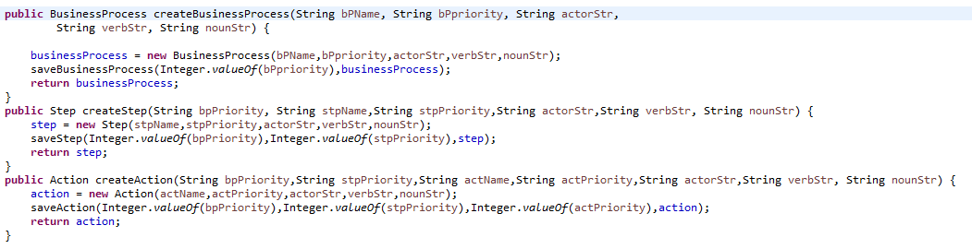
Applying Patterns
Creator Pattern:
Problem: Object Of BusinessProcess, Step and Action should be created from some entity.
Solution: BPController Class is creating objects for BusinessProcess,Step and Action.

Slide 34
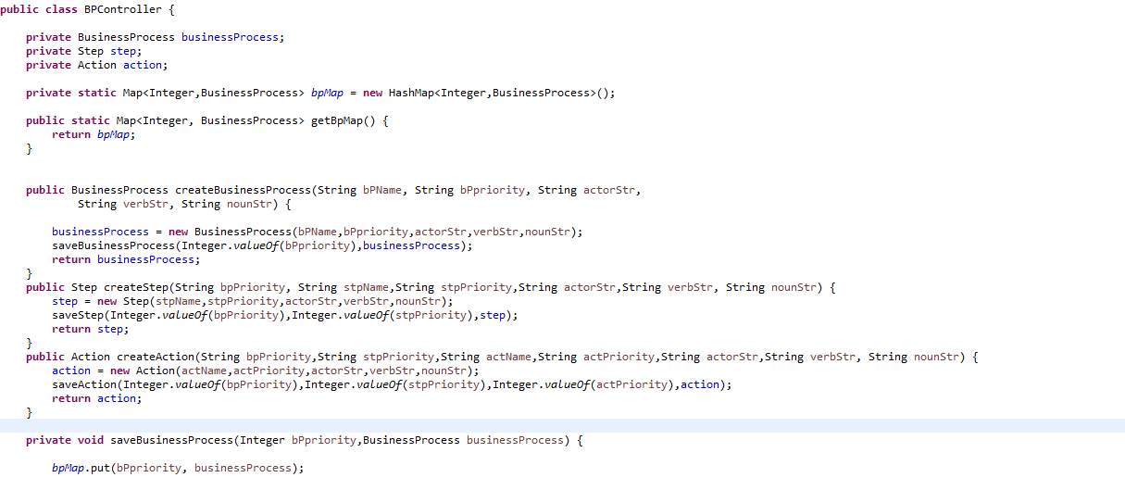
Applying Patterns
Controller Pattern:
Problem: Client’s request should be handled separately.
Solution: BPController Class is taking care of handling request of GUI.

Slide 35
Applying Patterns
Controller Pattern:

Slide 36
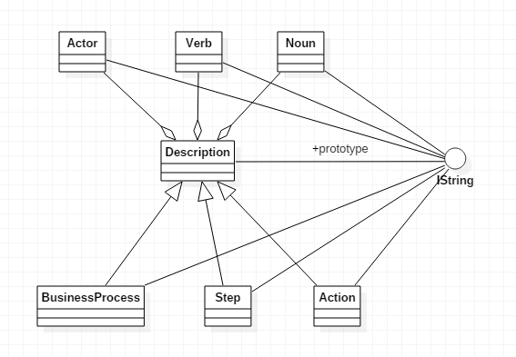
Applying Patterns
Prototype Pattern:
Problem: Every class has common getString().
Solution: Instead of creating different class for each class we have created Istring Interface.

Slide 37
THANK YOU

